Slide 1
DevOps Project
Motaylo Anton

Slide 2

Task in the project:
Task in the project:
• Creating a web project;
• Adding the project to GitHub (add, commit and push);
• Building the web project.

Slide 3









commit
webhook
run
Dockerfile
create image
web-site

Slide 4
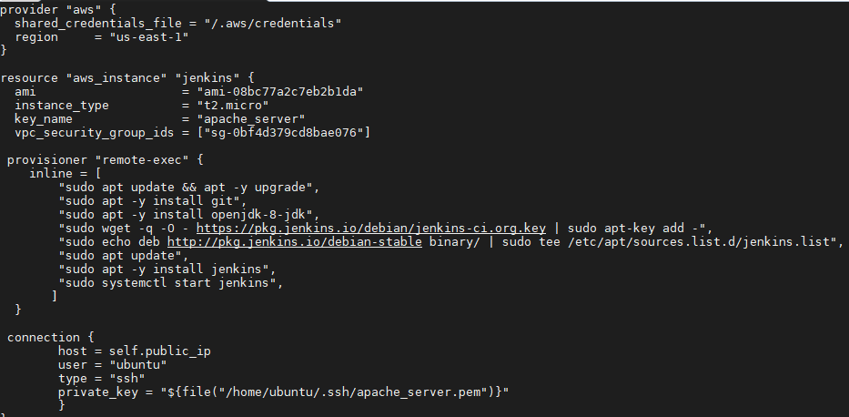
Terraform File

Slide 5
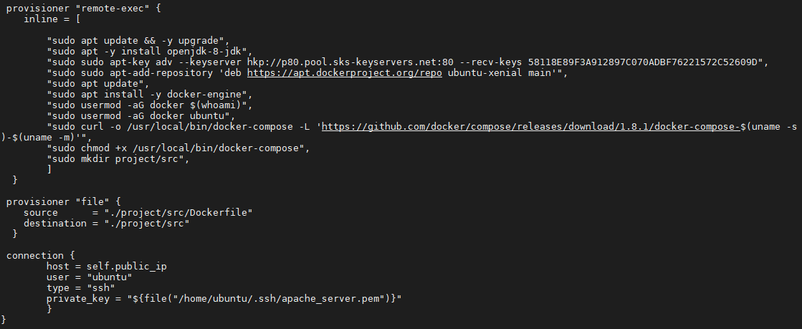

Slide 6
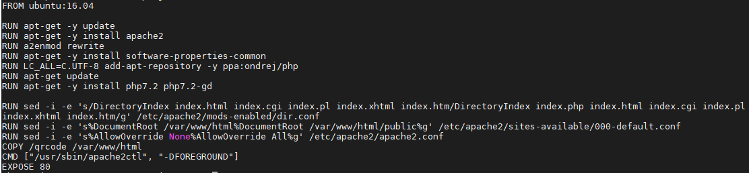
Dockerfile

Slide 7
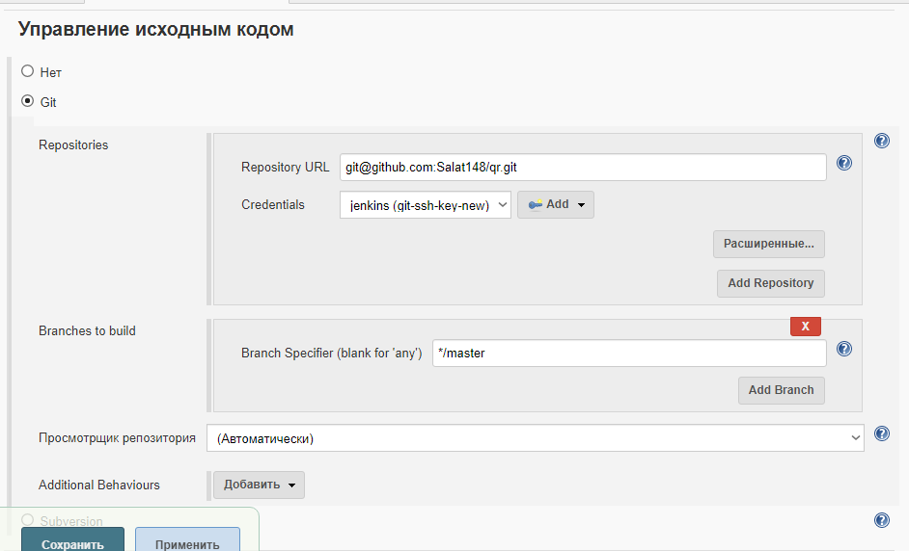
Jenkins settings

Slide 8
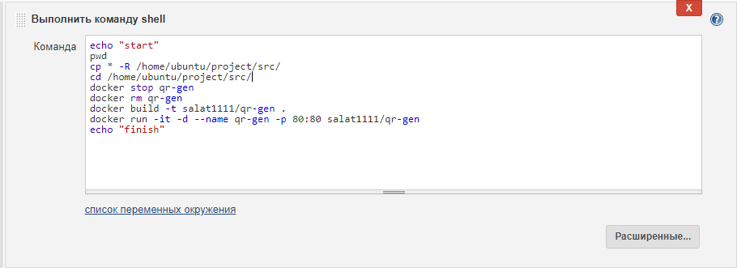

Slide 9
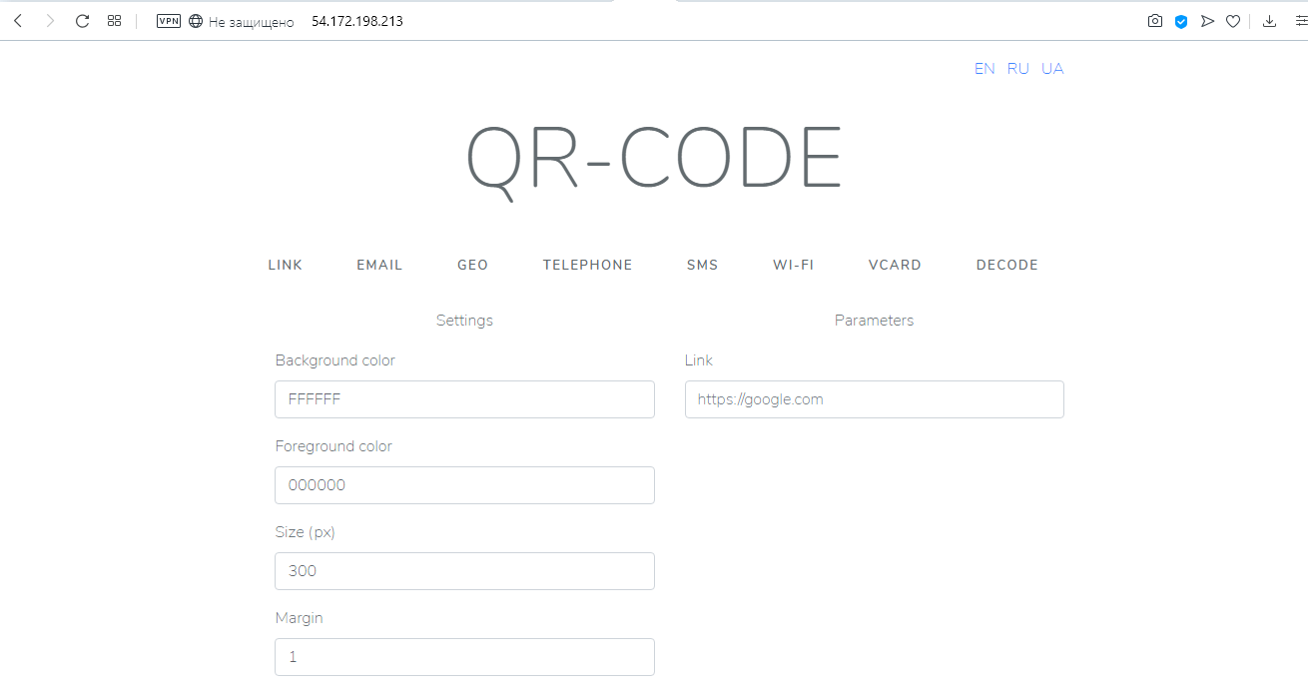


Result

Slide 10
Thanks for attention

